Slide 1
New GCC Setup Landscape – H1 2026
July 2026

Slide 2





Summary - H1 2026 at a Glance
~62
63%
74%
32
4
new GCCs established/ announced
US-headquartered
chose Bengaluru or Hyderabad
are emerging / mid-market firms
Established in emerging / tier-2 cities
Jan–Jun 2026
39 of 62 companies
46 of 62 GCCs
Less than $1Bn annual revenue
Kochi, Vizag, Coimbatore, Jaipur leads
What the H1 cohort tells us
Breadth over blockbusters. This is a long tail of mid-market and emerging companies, not a handful of giants — only 3 are Fortune Global 500 and 12 are Forbes Global 2000. India is now the default first move for smaller global firms, not just enterprises.
Concentrated landing, widening origin. Two cities absorb ~73% of new centers even as parents span 12 countries and 15 sectors — talent depth still trumps cost arbitrage when picking a location.
Source: ANSR Research, ANSR GCC Database

Slide 3

























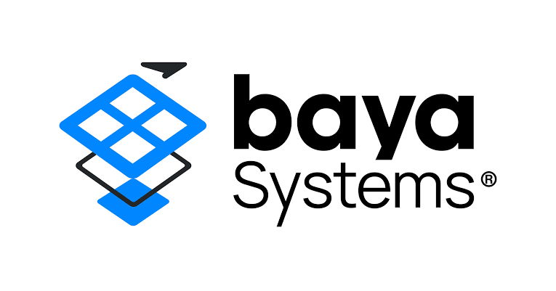
















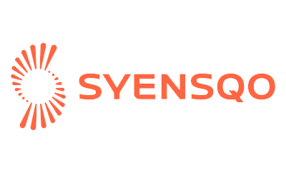














List of Companies - Logos

Slide 4
Parent-company geography
BY REGION
TOP SOURCE COUNTRIES
40
North America
65% of new GCCs
19
Europe
31% of new GCCs
3
Asia-Pacific
5% of new GCCs
North America drives nearly two-thirds of the cohort (40 of 62), led by 39 US companies. Europe contributes a diverse 20 — Germany and the UK tied at 5 and 6 respectively — while Asia-Pacific origins (Australia, Japan) remain at 3.
Source: ANSR Research, ANSR GCC Database

Slide 5
India location choices
73%
in Bengaluru + Hyderabad
46 of 63 centers
4
chose a Tier-2 city
Kochi, Vizag, Coimbatore, Jaipur
4
went multi-city at launch
US Bank, Simcorp, Unipart, Exol
Bengaluru (25) and Hyderabad (21) still anchor the map. Tier-2 adoption is real but early — 4 centers — signalling headroom as talent and incentives mature.
Counts include multi-city GCCs; totals exceed 62.
Source: ANSR Research, ANSR GCC Database

Slide 6
Industry composition
~56%
of GCCs sit in just three sectors — Software & Internet, BFSI, and Healthcare & Lifesciences (35 of 62).
An AI-and-software tilt. Software & Internet leads (15), with AI-native names across drug discovery, voice, agentic platforms, MarTech and security. BFSI (11) and Healthcare (9) bring regulated, IP-heavy work — but the tail spans 12 more sectors from aerospace to CPG, showing GCCs are no longer a tech-only play.
Source: ANSR Research, ANSR GCC Database

Slide 7
Company profile of the cohort
OWNERSHIP
REVENUE BAND
3
Fortune Global 500 companies
12
Forbes Global 2000 companies
27%
are sub-$100M companies
33 private / 29 public
A mid-market and emerging-company wave. The single largest revenue band is under $100M (17 firms, 27%), and private companies outnumber public. India entry is no longer reserved for global giants — it has become an early-stage capability strategy.
Source: ANSR Research, ANSR GCC Database

Slide 8

What it means
The entrant base is broadening
01
Location is still talent-first
02
Sub-$100M and private firms now lead the pipeline. India is the default first-move for emerging global companies, not only enterprises — a larger, faster-moving demand pool.
Bengaluru and Hyderabad absorb ~73% of new centers. Tier-2 (4 GCCs) is emerging but not yet mainstream — depth of skills still outweighs cost in the location decision.
Demand is diversifying by sector
03
Partner-led builds favour ANSR
04
Beyond software, BFSI and healthcare bring regulated, IP-heavy mandates, and the tail reaches aerospace, energy and CPG — GCC work is going mainstream across industries.
Where a setup partner is disclosed, ANSR leads with 60% share. As first-time and smaller entrants scale, demand for build-operate expertise should keep rising.
Source: ANSR Research, ANSR GCC Database

Slide 9
Thank You!
The contents of the presentation are only for your internal use only. You may not disclose the presentation or portions or summary there of externally, including to your affiliates. In the event any such disclosure is necessitated on account of operation of law or any other exigency, you may do so only after obtaining our prior approval for such disclosure. Also, we shall not be responsible for any reliance on our presentation, placed by an external party to whom the presentation or portions or summary thereof are disclosed even if such disclosure is with our prior approval.

